Slide 1
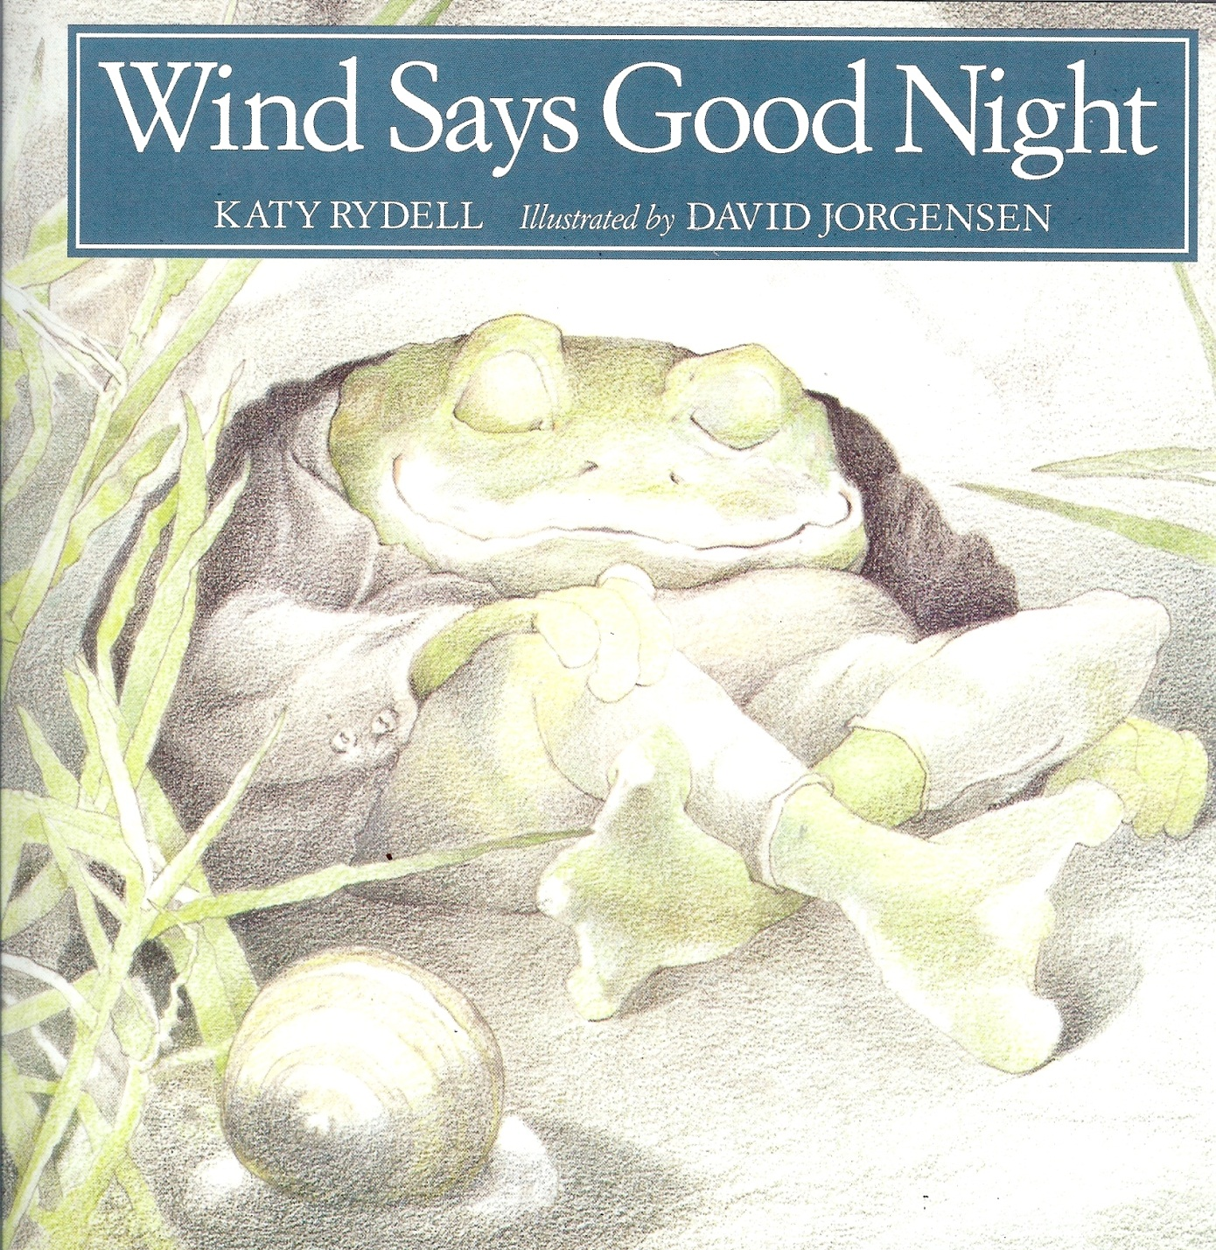

Slide 11
Moon stopped shining.

Slide 12
Moth stopped dancing.

Slide 13
Frog stopped strumming.

Slide 14
Cricket stopped playing.

Slide 15
Mockingbird stopped signing.

Slide 16
At last the night was dark, and quiet, and still. The child snuggled under the warm blankets, closed tired eyes, and fell asleep.

